Slide 1
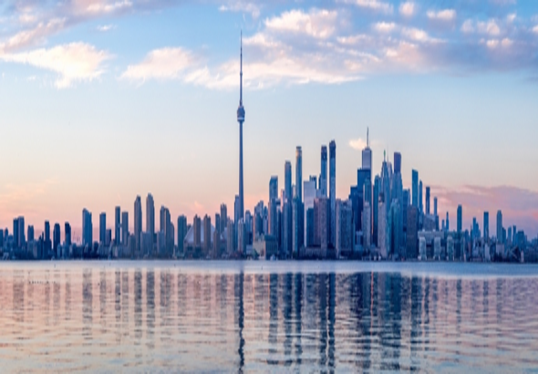
INDIAN RESTAURANT IN TORONTO
A DATA SCIENCE APPROACH
BY,
Anshul Sharma
mail.ansh@gmail.com

Slide 2
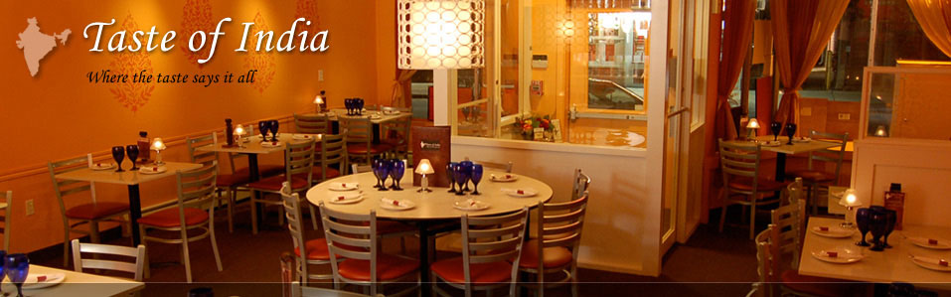
INTRODUCTION This report is intended to provide an insight on “how data science can be used to solve a business problem?”
BUSINESS SCENARIO BACKGROUND
This report will try to address the following question for any entrepreneur who is planning to invest in opening a new Indian restaurant in Toronto city.
How many Indian restaurants are already present in Toronto City?
Which neighbourhoods in Toronto city has an Indian restaurant?
Which neighbourhoods in Toronto city will be ideal to start a new India Restaurant?
What are the descriptive highlights of these ideal neighbourhoods?

Slide 3
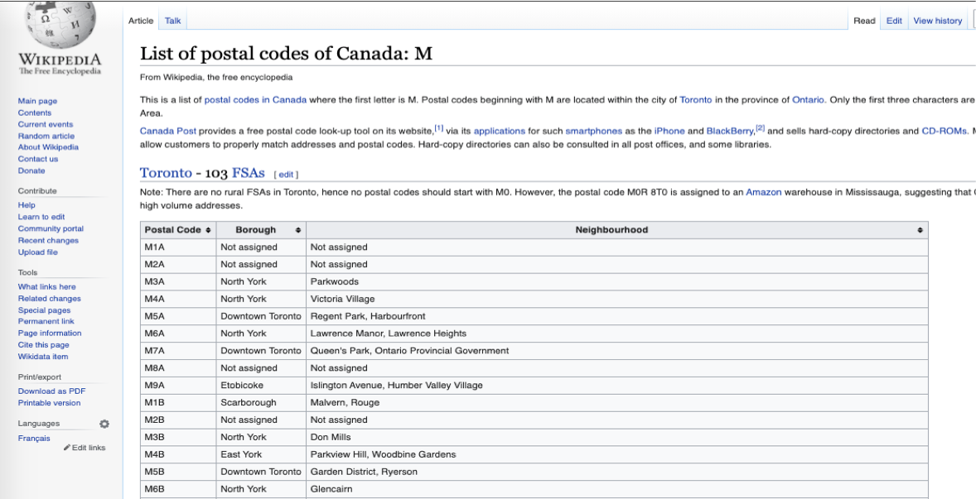
DATA OVERVIEW
Below are the list of datasets used in the report and background study.
Postal codes of Canada
Geographical coordinates of the postal codes.
Venues data of Toronto city.
DATA DESCRIPTION AND ACQUISITION
1. Postal Codes of Canada – Web Scraping
A list of all the postal codes with assigned Boroughs and neighbourhoods is available on a wiki page.
https://en.wikipedia.org/wiki/List_of_postal_codes_of_Canada:_M
Web Scraping - Using pandas.read_html()

Slide 4
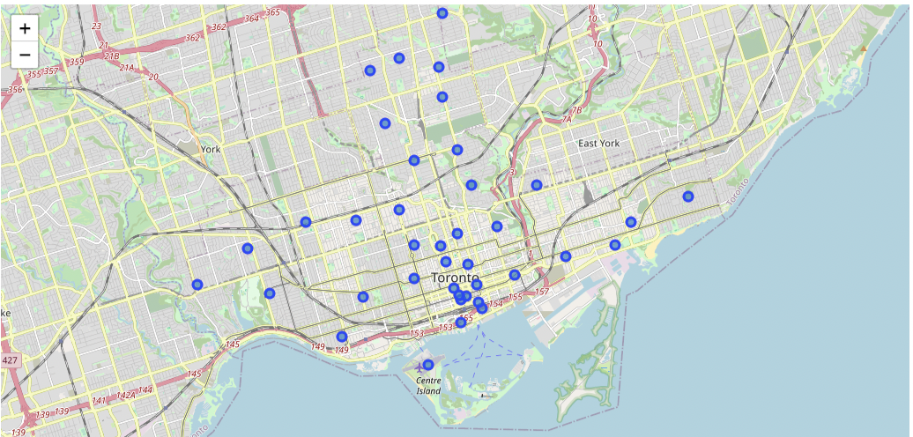
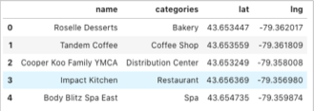
DATA DESCRIPTION AND ACQUISITION
2. Geographical coordinates of the postal codes – Web Scraping
This is the main input for acquiring other venue related data.
This data can be extracted using
Geocoder Python package
Using a direct link to a csv file http://cocl.us/Geospatial_data
Boroughs of Toronto plotted on Map using Folium library.
3. Venues data of Toronto City – Foursquare API
The venue data details all types of venues, their category and geo-coordinates for any desired location.
For this study, the venue data was extracted using the Foursquare API.
The venue data consists of the following as shown in figure below.
Venue Name
Venue Category
Venue Latitude
Venue Longitude

Slide 5
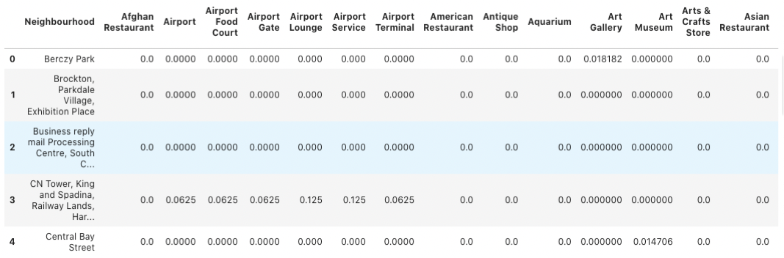
DATA DESCRIPTION AND ACQUISITION
4. Final dataset for analysis
The datasets 1-3 were merged together to create one data frame.
the data frame had to be transformed to represent the venues in terms of the neighbourhoods.
the rows with same neighbourhood names were grouped together.
One hot encoding was used for the same.

Slide 6
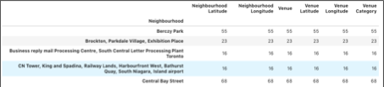
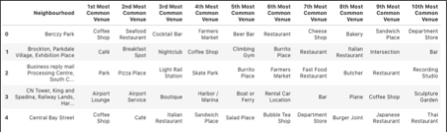
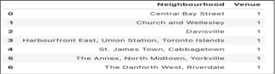
Methodology
A. EXPLORATORY DATA ANALYSIS
For the exploratory data analysis the following was done.
A1. TOTAL VENUE CATEGORIES.
The number of ‘to-do’ options available to individual living in Toronto.
A2. TOP 10 VENUES
The top 10 venues by their occurrence in the neighbourhood.
are any Indian restaurant in top 10 category in any neighbourhood?
A3. INDIAN RESTAURANTS IN TORONTO.
The total number of Indian restaurants and their frequency of occurrence in each of the neighbourhoods.

Slide 7
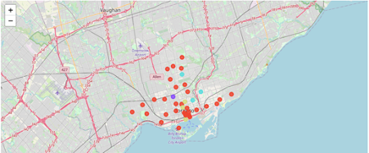
Methodology
B. INFERENTIAL STATISTICS - MACHINE LEARNING
I have used K-mean clustering method for clustering the neighbourhoods.
Number of clusters - 4
The following clusters were created.
Cluster 1 – Red
Cluster 2 – Purple
Cluster 3 – Aquamarine
Cluster 4 – Dark khaki'
Neighbourhoods clusters plotted on a map

Slide 8
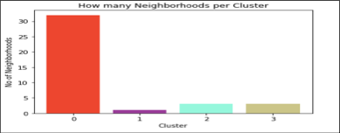
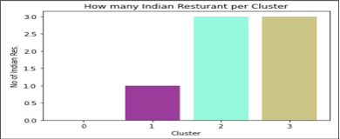
RESULTS
Following analysis were done to identify the best neighbourhoods for opening an Indian Restaurant.
1. Neighbourhood in clusters
Cluster 0 has highest number ie 32 neighbourhood in it. Followed by cluster 2 and 3 with 3 neighbourhoods each in them and finally cluster 1 with just one neighbourhood in it.
2. Indian restaurants across clusters
There are no Indian restaurants present in cluster 0. Also there are 3 Indian restaurants present in cluster 2 and 3 each and 1 in cluster 1.
Cluster 0 - Red
Cluster 1 - Purple
Has no Indian restaurants in it.
Spread across all 4 Borough 32 Neighbourhoods.
Ideal cluster
Present in only 1 borough
Only 2 neighbourhoods in this cluster
1 Indian Restaurant already present in it
Not an ideal choice
Cluster 2 - Aquamarine
Cluster 3 - Dark kaki'
Present in only 3 borough
Spread across 5 neighbourhoods
3 Indian Restaurant already present.
Not an ideal choice
Present in only 3 borough
Spread across 5 neighbourhoods
3 Indian Restaurant already present.
Not an ideal choice

Slide 9
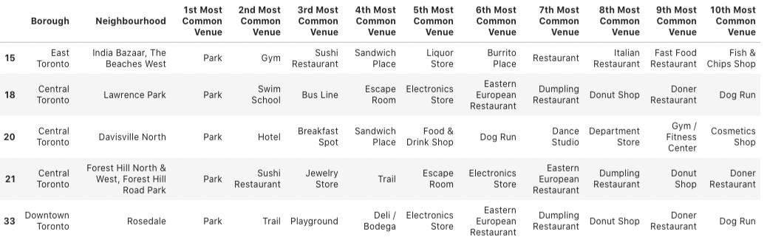
DISCUSSION
Clearly cluster 1, 2, 3 are not our preferred choices to start the Indian restaurant
Cluster 0 seems to be suitable.
Within cluster 0 there are few neighbourhoods which have very common venues like Parks and bars.
This would give us a good sense of which neighbourhood would be a better choice.

Slide 10
CONCLUSION
Only cluster 0 spread across 32 neighbourhoods and with no existing Indian Restaurant present in it is the ideal choice to start a new Indian Restaurant.
Potential neighbourhoods with lots of parks and bars around
India Bazaar
The Beaches West
Little Portugal
Trinity
This Analysis can be made more robust by adding demographic data. This will create clusters with more detailed features and will help us making more informed decisions.

Slide 11
THANK YOU
Find me on LinkedIn and the codes for this project on GitHub

